Slide 2
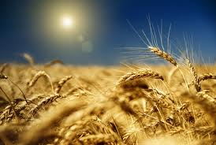
AGRO-TECHNOLOGY OF BARLEY
(Hordeum vulgare)

Slide 3
Contents
Introduction
Uses
History & Origin
Area & Production
Crop botany
Climate & Soil
Production Technology

Slide 4
Introduction
Barley is a rabbi cereal grain crop
Ranked 4th in cereal
Locally called ‘jao’(Urdu)
Old English word “Beare”
Latin word farina "flour"
The Old English word for 'barley' was bære
First citation of the form bærlic in the Oxford English Dictionary dates to around 966 AD

Slide 5
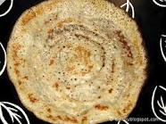
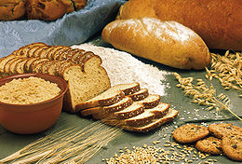
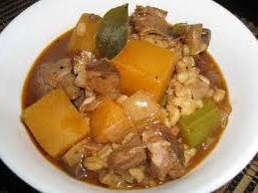
Uses
Animal feed
Health food
Algicide
Beverages
Bakery products

Slide 6
History & Origin
Barley was one of the first agricultural domesticates together with wheat, peas etc.
Being grown by babylians, Chinese
Originated in Asia & Ethiopia
Production started in Mesopotamia
Earliest remains reported in 8000 B.C. in Iran
Staple cereal of ancient Egypt

Slide 7
Top ten barley producers (million metric tone)
Russia 17.9
France 12.9
Germany 12.3
Ukraine 11.8
Canada 9.5
Australia 8.1
Turkey 7.3
United Kingdom 6.8
United States 4.9
Poland 4.0
World total 152

Slide 8
Area & Production
World wide
Area : 56.6 M ha
Production : 152 M tonns
In Pakistan
Area : 0.08 M ha
Production : 0.078 M tonns
Mostly grown in Deir , Bahawalnager, khuzdar, Chitral, Bajour agency etc.
Bajour contributes 20% of country`s production

Slide 9
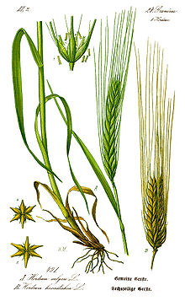
Crop Botany
Family Poaceae
Self pollinated
Monocot
Diploid with 14 chromosome
Inflorescence is spike
Has short duration than wheat
Glumes contain 3 florets

Slide 10
Scientific Classification
Kingdom -------------------- Plantae
Phylum -------------------- Spermatophyta
Class -------------------- Monocotyledons
Order -------------------- Cyperales
Family -------------------- Poaceae
Genus ------------------- Hordeum
Species ------------------- Hordeum vulgare

Slide 11
Locality & Soil
Adapted to temperate region
Optimum temperature range is 15 -20 ⁰c
Productive even under adverse condition
Min. 200-250 precipitation required
More efficient water user
Drought & moderately salt tolerant crop
Well drained loams to clay loam soil
Usually planted on lass fertile marginal land

Slide 12
Production Technology
Seed bed preparation
2-3 ploughing with planking
Seed rate 30-35 kg/acre
Germination more than 85%
Weed free
Free from insect pest and disease infestation
Seed Treatment : Topsin-M , Benlate
@ 2g/kg seed

Slide 13
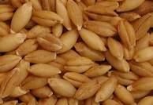

Slide 14
Varieties
Frountier-87
Clipper
Barley-dwarf
Tj-70
Neelum

Slide 15
Time of sowing
Mid Oct. to Mid Nov.
Methods of sowing
Broadcasting
Line Sowing: R-R: 9”
Can be sown by :
Wet Method
Dry Method
Gup-chhat Method

Slide 16
Irrigation
2-4 at critical growth stages
At Tillering stage
Booting stage
Grain filling stage
Fertilizer requirement
50:25 NP kg/acre
1 bag DAP +1.5 bag Urea
Urea applied in split doses in irrigated areas

Slide 17
Weed managment
Important weeds
Convolvulus arvensis(Lehli)
Avena fatua(Wild Oat)
Cyperus rotundus(Deala)
Chenopodium album(Bathu)
Better adapted to compete with weeds
Minimum need of weeding & interculture
IWM best option

Slide 18
Plant protection
Insect pests
Termites , Cutworms , Army worm , Aphids , Shoot fly , Surface grass hopper
Diseases
Powdery Mildew, karnal bunt, Loose smut of Barley, Rust
IPM is best option

Slide 19
Harvesting & Storage
Done earlier than wheat
Harvested at physiological maturity
Heads bend when over mature
Done by sickle or through Reaper
Threshing by wheat thresher
Sun dried for 2 or 3 days
Moisture content should be less than 12%

Slide 20
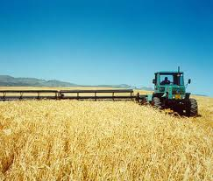

Slide 21
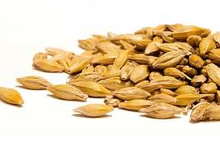
Yield
650-900 kg/ha

