Slide 1
Aroma compounds

Slide 2
OUTLINE
Definition
Threshold Value
Aroma Value
Off Flavor
Aroma Defects
Individual Aroma Compounds

Slide 3
WHAT ARE AROMA COMPOUNDS?
A chemical compound has a smell or odor when two conditions are met:
The compound needs to be volatile
Sufficiently high concentration
OR
“Aroma substances are volatile compounds which are perceived by the odor receptor sites of the smell organ.”

Slide 4
THRESHOLD VALUE
“The lowest concentration of compound that is just enough for the recognition of its odor is called the odor threshold.”

Slide 5
AROMA VALUE
“Compounds with high aroma value contribute to the aroma of food.”
Ax = cx/ax
Ax= Aroma Value
cx= Conc. of compound X
ax= Odor threshold of compound X

Slide 6
OFF-FLAVOR/TAINTS
An off-flavor can arise through
Foreign aroma substances
Loss of key odorants
Concentration ratio of individual aroma substance
Not present in food

Slide 7
Aroma Defect
Food Processing
Food Storage
Food of Animal Origin
Plant Food

Slide 8
FOOD PROCESSING
Thermal Treatment
Canning
Disinfection
Fermentation Defects
Preservation

Slide 9
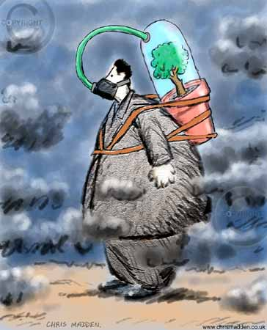
PLANT FOOD
Environmental Pollution
Biocides

Slide 10
FOOD STORAGE
Microbial Deterioration
Reactions of Food Constituents
Oxidation
Non-enzymatic browning
Transfer of Aroma Compounds
Packaging

Slide 11
INDIVIDUAL AROMA COMPOUNDS

Slide 12
Cyclic Terpenes

Slide 13
ESTERS
Compound Name | Fragrance | Natural Occurrence
Methyl formate | Ethereal | ----
Methyl acetate | Sweet | ----
Ethyl acetate | Sweet | Wine
Isoamyl acetate | Fruity, banana pear | Banana plant

Slide 14
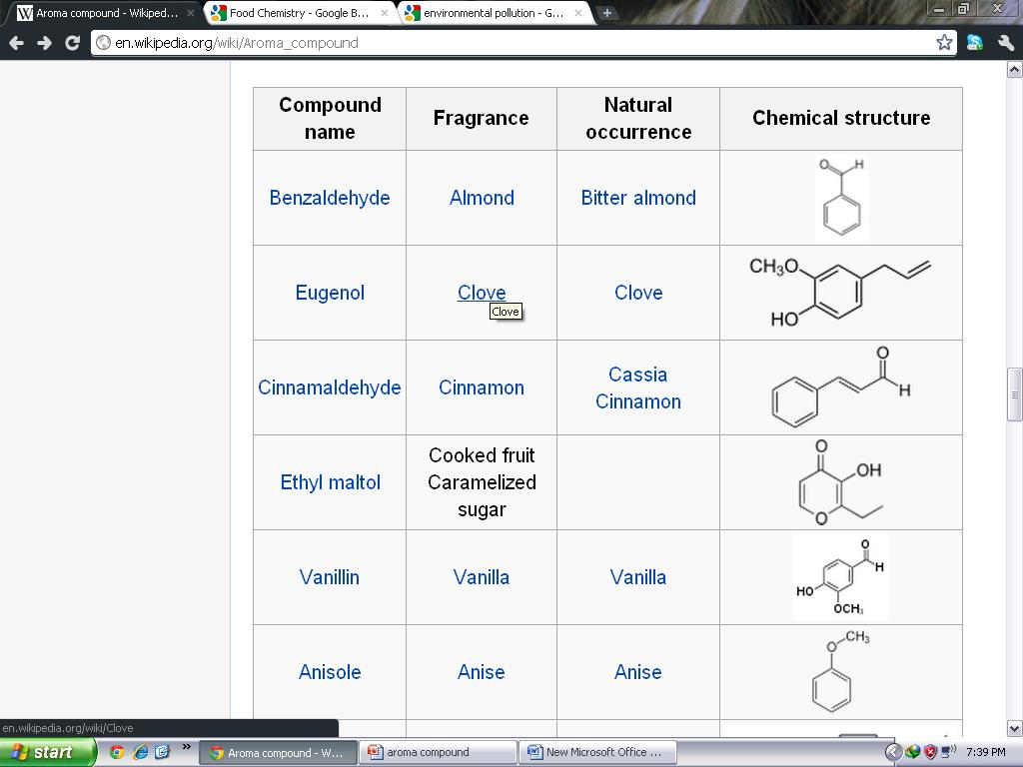
Aromatic

Slide 15
LINEAR TERPENES
Compound Name | Fragrance | Natural Occurrence
Myrcene | Woody complex | Verbena
Geraniol | Rose flowery | Lemon
Nerol | Sweet rose, flowery | Lemongrass
Linalool | Floral, sweet woody | Coriander

Slide 16
MUNEEB KHAN

