Slide 1


Slide 2
Water logging what is water logging?
    Rising of water table in the upper soil surface
    in the root zone which affects the plant growth and development
    OR
    Saturation of soil with water

Slide 3
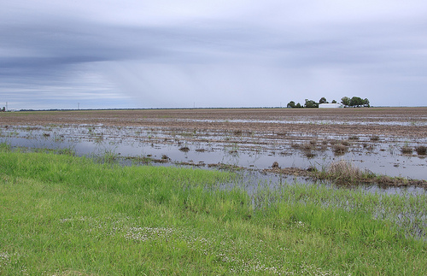
water logging
Water logged soil

Slide 4
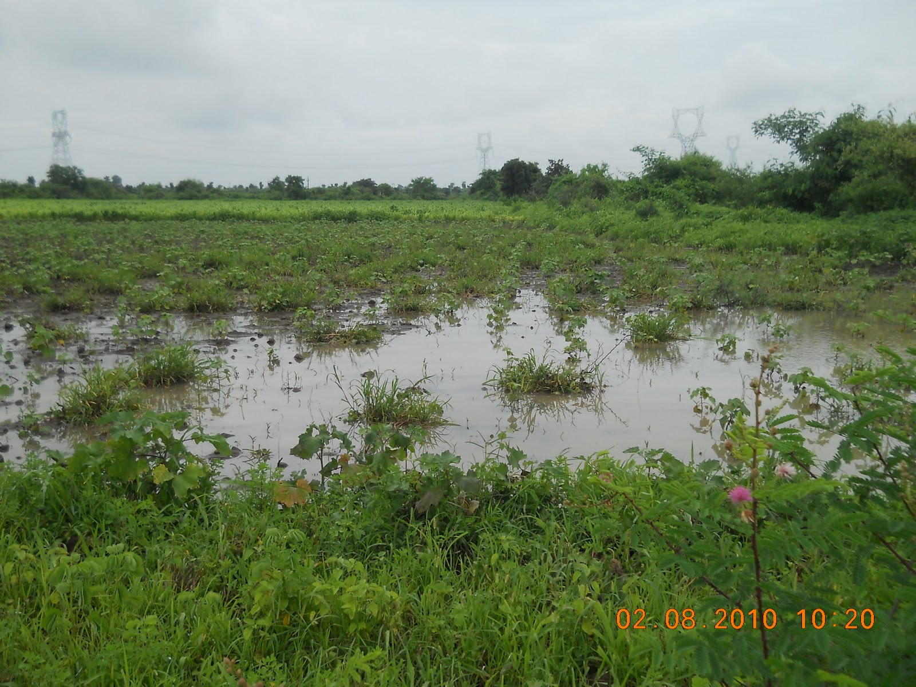
Water logging

Slide 5
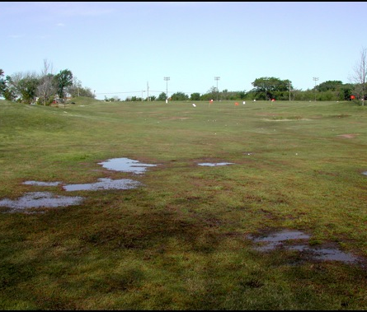
Water logging

Slide 6
Causes of water logging
High rainfall
high clay content
low permeability of subsoil
Seepage from rivers and canals
Poor drainage
Over irrigation
Development efforts mad by man such as irrigation network ,road and rail links, replacement link canals etc

Slide 7
Worldwide waterlogged soil percentage
Worldwide, about 10 percentage of all irrigated land suffers from water logging
As a result, productivity has fallen about 20 percent

Slide 8
Water logging problem in Pakistan
Over the years, about 40 per cent of the irrigated cropping land in Pakistan, which produces around 90 per cent of the total agricultural output of the country has come under water logging

Slide 9
Problems of water-logged soils
Poor aeration :Due to water-logging, a part of the soil air moves out into the atmosphere as it is displaced by the incoming water
Soil structure: Continuous water stagnation destroys the soil structure and makes the siol compact

Slide 10
Problems of water-logged soils
Soil temperature: water-logging lower down the soil temperature.
Soil pH: There are reversible pH change of the floodesoil, pH tends to
increase in acidic soils and decrease in alkaline soila, undoubtedly pH is alter towards narmal

Slide 11
Problems of water-logged soils
Availability of nutrients.
Nitrogen- nitrogen deficiency is extremely common in water-logged soil.
Phosphorus: The inorganic form of P are usually present at higher lelels in flooded siols thenin upland soils
Sulphur: Sulphur deficiency has been reported from many lowland area.

Slide 12
Effects of water logging on crop plant
Water logging affects a number of biological and chemical processes in plants and soils that can impact crop growth in both the short and long term.
The primary cause of water logging in crop plants is oxygen deprivation
While, Plants need oxygen for cell division, growth and the uptake and transport of nutrients.

Slide 13
Effects of water logging on crop plant
Generally, the oxygen level in a saturated soil reaches the point that is harmful to plant growth after about 48-96 hours.
Waterlogged conditions also reduce root growth
It causes to wilt plants
And ultimately plants dye

Slide 14
Symptoms of waterlogging
  yellowing of leaves
  dry angular blotches on leaves
  A root sample will show blue-black roots
  · Roots may rot away completely

Slide 15
Symptoms of waterlogging
There may be dark areas along the midrib
and areas within the leaf go brown, especially in evergreen leaves.
Herbaceous plants may fail to sprout in spring, or leaves can open and then die.
Plant growth is stunted

Slide 16
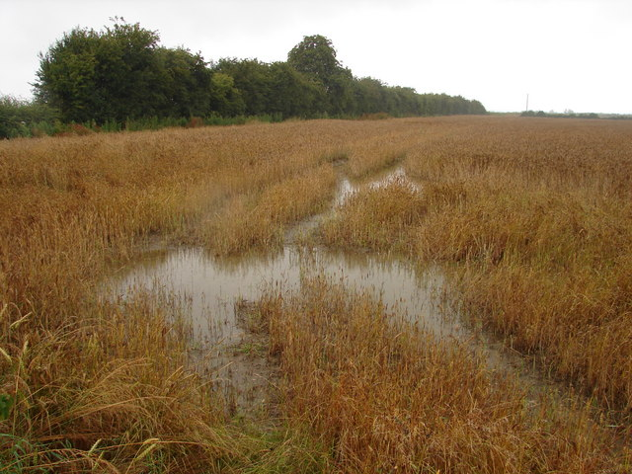
Symptoms of Waterlogged crop

Slide 17
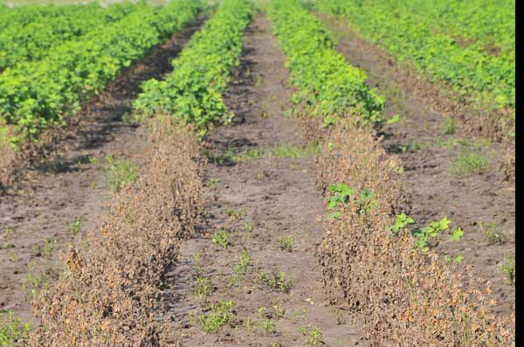
Symptoms of Waterlogged crop

Slide 18
Some crops which can tolerate water logging
  HIGH TOLERANCE; sugarcane, potatoes, rice, willow, plum, broad beans strawberries
  MEDIUM TOLERANCE; sugerbeet, wheat, oats, citrus, bananas, apple, barley peas,, cotton pears, blackberries,

Slide 19
Sensitive crops to water logging
Maize, tobacco, peaches, cherries, olives, peas, beans, date palm

Slide 20
Control of water logging
Control seepage
Breaking of hard pan
management of drainage lines for efficient water flow
Management of surface water-flow to avoid surface ponding

Slide 21
control of water logging
Only apply water when necessary ,not over irrigate
Sow highly tolerant crops. sugercane,rice,straberries etc.
Increase deep rooting vegetation for greater utilization of water from the soil.

Slide 22
control of water logging
Improve drainage of the soil by adding organic soil matter
creating raised beds.
selection of best crop which can tolerate waterlogging such as rice

Slide 23

Thank you

