Slide 2
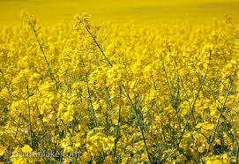
Production technology of
RAPESEED AND MUSTARD

Slide 3
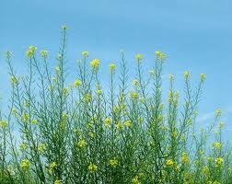
commonly known as sarson family: cruciferae
Different types:
Rape Seed:
Toria: B.campestris
Gobi sarson: B.napus
mustard:
raya: B.juncea
taramira: eruca sativa

Slide 4
ORIGIN & History
the place of region is not definitely known
It’s cultivation has been traced to 2000 B.C in India,China and Japan.
Brassica seeds were used for oil extraction first time in India.
China and India are the world’s largest producer.
Lance Gibson and Garren Benson, Iowa State University, Department of Agronomy
Revised January 2002.

Slide 5
INTRODUCTION
Annual rabi plant
Self pollinated crop
Plant height 50-200cm
“0 0” varities
90% grown as barani crop

Slide 6
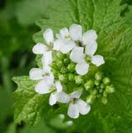
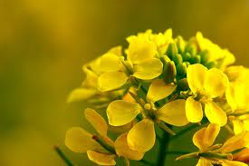
INTRODUCTION
World production 600 million metric tonns
World area 118 million hectare
Total Pakistan area 3 lac hectare
Total production 233000 tonnes
Contribution of different provinces to total area
Punjab 50%
KPK 17%
Sindh 30%
Balochistan 3%

Slide 7
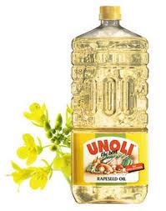
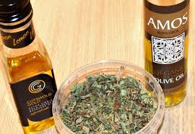
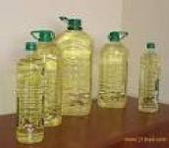
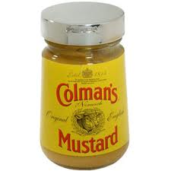
Uses
As vegetable
Seeds for oil extraction
As fodder and forage
Oil use for cooking,making pickles,
for making soaps and paints.

Slide 8
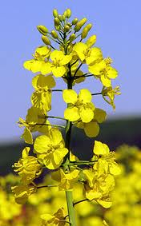
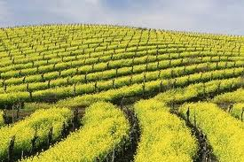
Production Technology

Slide 9
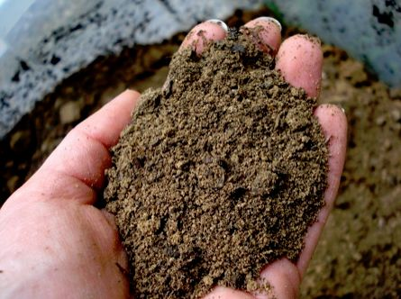
Soil and climate
Mostly grown in temperate regions.
Grown in variety of soils from sandy to clayey soils.
pH 5.5—7.5
Tem. 30 c°

Slide 10
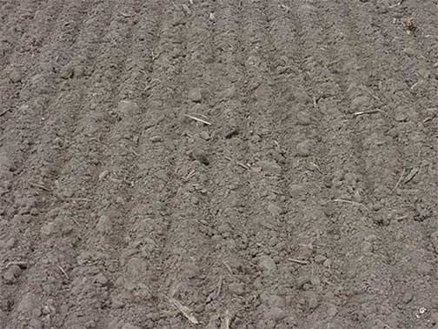
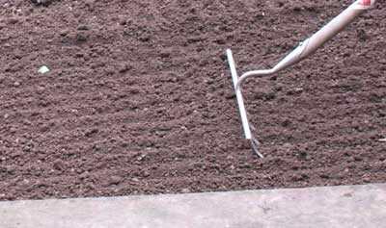
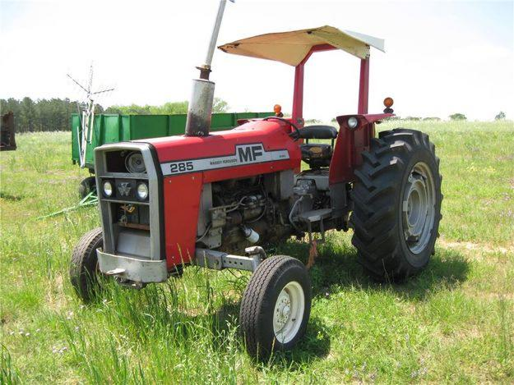
Seed bed preparation
Fine and compact bed needed
Land is loosened 20 to 25 cm deep through plowing or disking 2–3 times
Planking

Slide 11
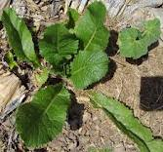
Sowing time
these are planted in two seasons
Winter rabi
Oct-nov to april-may
Zaid kharif crop
Early sept-end of december

Slide 12
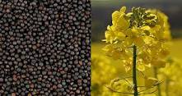
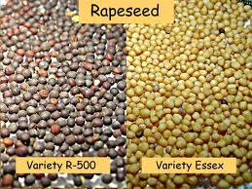
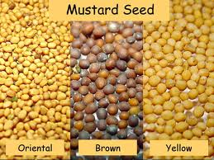
Seed rate and verities
4—6 kg/ha (for broadcast sowing)
Punjab
poorbi raya,zafar 2000,peela raya,raya anmol
Sindh
Early raya,s-9
KPK
Tower,altex

Slide 13
Sowing method
Broadcast
Fine seedbed preparation
Line sowing
R×R= 30-40cm
P×P = 10-15cm

Slide 14
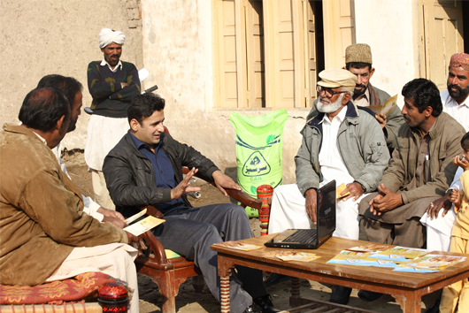
Fertilizer
Punjab 40:40 NP kg/ha
Sindh 112:56 NP kg/ha
KPK 75:50 NP kg/ha

Slide 15
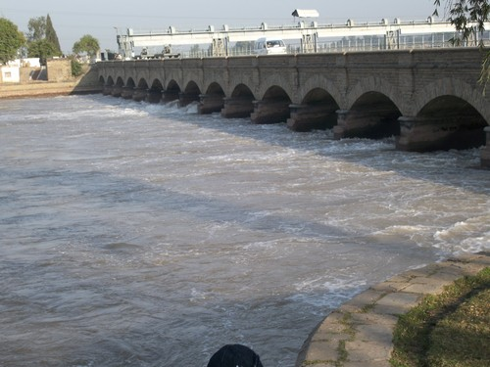
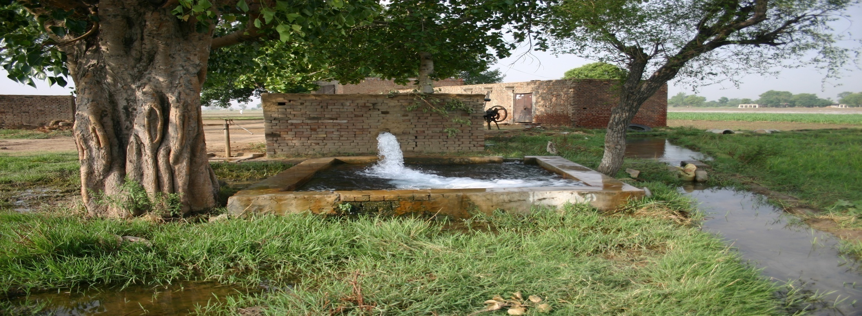
Irrigation
Sarson 3-4 irrigations
Toria 2-3 irrigations
Taramira 1-2 irrigations
First irrigation applied after one month of sowing.
Then irrigate at the interval of 20-25 days.

Slide 16
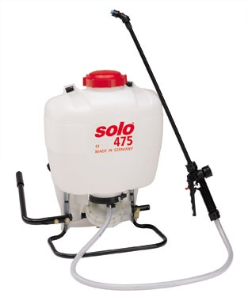
Weeds
Reduced yield 29—43%
Perennial Weeds
Field bindweed
Quak grass
`Canada thistle
Annual Weeds
Wild musterd
Volunteer cereals
Prickly lettuce

Slide 17
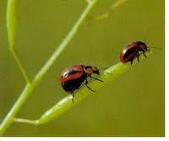
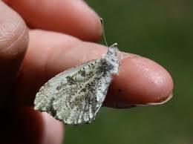
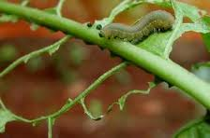
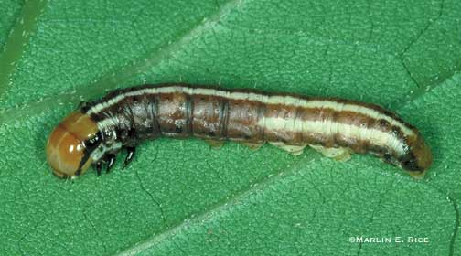
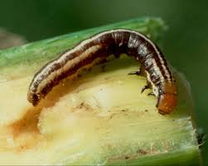
Plant protection measures
Seed dressing
vitavax
Benlate-m 45

Slide 18
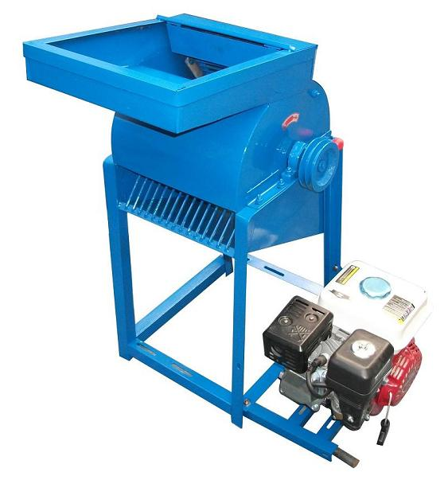
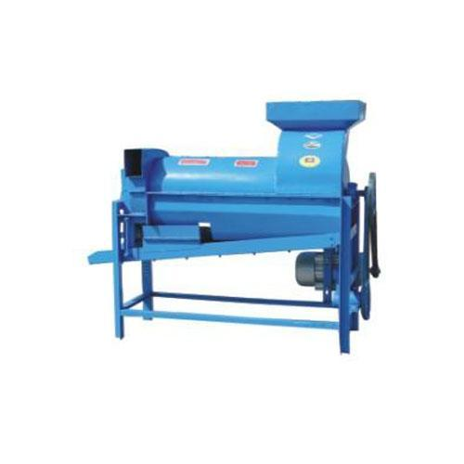
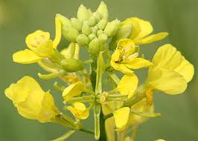
Harvest & storage
Stem and pods color changes to yellow
Seeds become dark
Seeds rattle when pods are shaken.
75% pods turn yellow
Crop matures in 180-200days
Usually havested with sickle

Slide 19
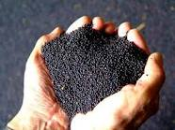
Yield
Punjab 900-1000kg/ha
Sindh 600-650kg/ha
Kpk 500-600kg/ha

