Slide 2
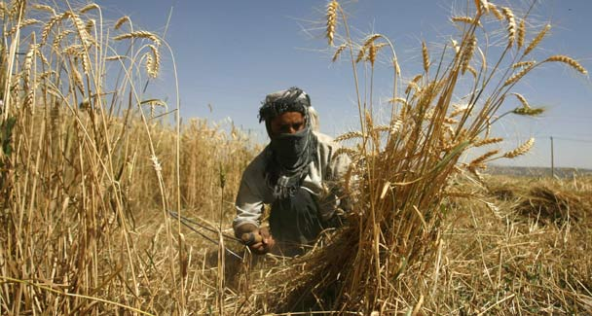
1
Production technology of wheat

Slide 3
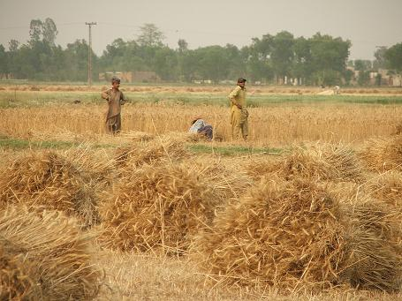
Wheat (T. aestivum)
Kingdom: Plantae
Division: Magnoliophyta
Class: Liliopsida
Order: Cyperales
Family: Poaceae
Genus: Triticum
Species: Triticum aestivum

Slide 4
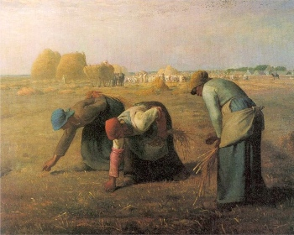
History & origin
Cultivation of wheat began to spread beyond the Fertile Crescent after about 8000 BC
spread of cultivated wheat started in the Fertile Crescent about 8500 BC, reaching Greece, Cyprus and India by 6500 BC, Egypt shortly after 6000 BC.
The early Egyptians were developers of bread and the use of the oven and developed baking into one of the first large-scale food production industries-

Slide 5
Economic importance
It is sown on 220 million hectares around the world with 564.6 million tons production, an average of 2500 kg grain per hectare
Pakistan stands at 10th place in terms of area (8.5 million hectares) and 59th in terms of yield (21.0 m ton) annually in world
The average per acre yield of wheat is estimated between 20 and 25 maunds and above it needs an extra effort as well as natural supporting factors.

Slide 6
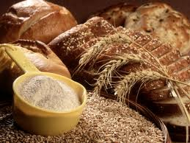
Wheat uses
Foods made with wheat are a major part of the diet for over a third of the world's people.
wheat can be found in some form at almost every meal.
Breads,
cookies,
cakes,
crackers,
macaroni,
spaghetti,
and other forms of pasta are made from flour, which is ground up kernels of wheat.

Slide 7
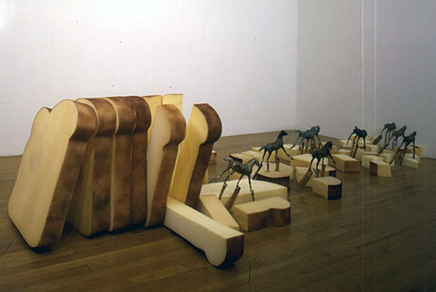
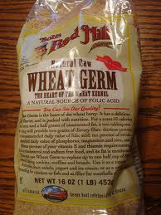
Nutritional value 100 g (3.5 oz)
Energy 1,506 kJ (360 kcal)
Carbohydrates 51.8 g
Dietary fiber 13.2 g
Fat 9.72 g
Protein 23.15 g
Thiamine (vit. B1) 1.882 mg (164%)
Vitamin B6 1.3 mg (100%)

Slide 8
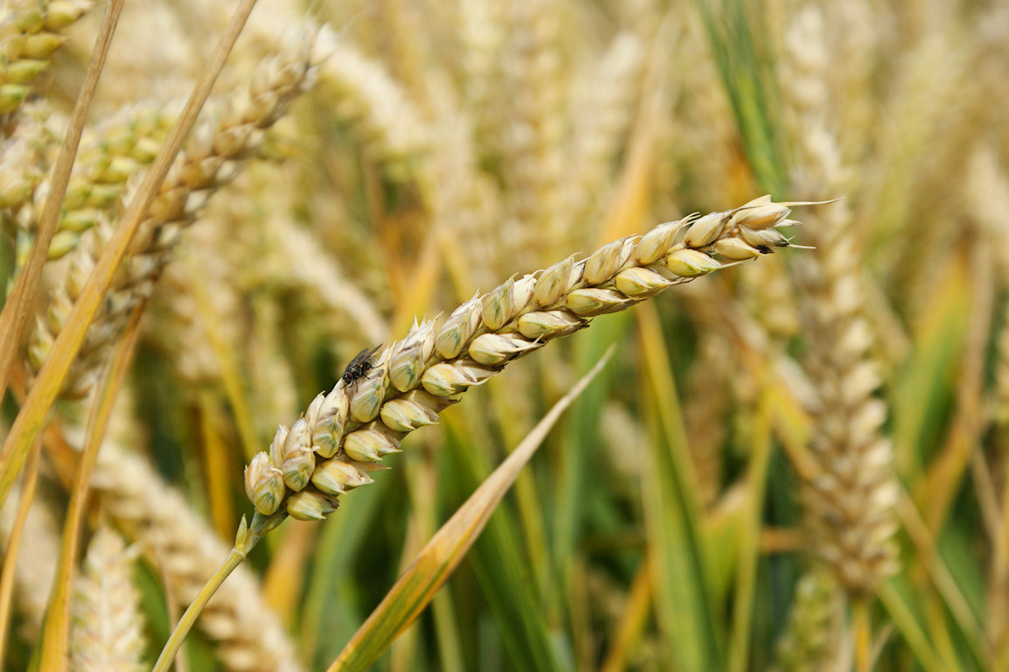
Production Technology

Slide 9
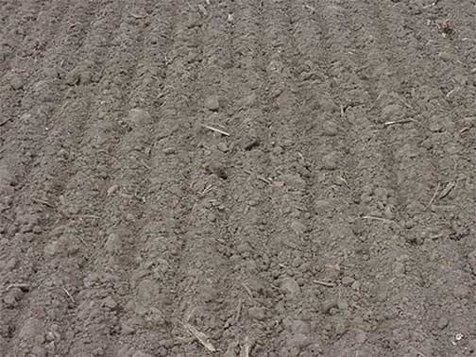
Soil and climate
Wheat is adopted to regions with cool season followed by dry warm season.
Best crop (cold winter & comparatively warm spring or summer with moderate rain fall)
Either on poorly drained and sandy soil
Sandy loam to clay soils are well
Silt to clay loam soils produced the best yield

Slide 10
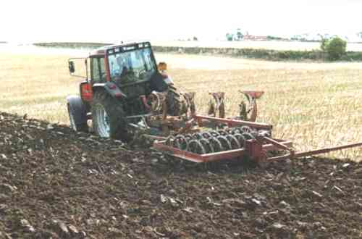
Cultural practices
Seed bed preparation manuring
Time of sowing
Seed rate &planting method
Insect, pest control
Inter culture and weeding
Harvesting
Storage
processing

Slide 11
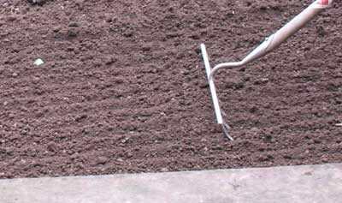
Seed bed preparation
The land should be plowed as soon as the previous crop is removed
In rain fed areas field should be deep plowed at onset of moon soon
In irrigated areas land should be plowed to control weed and to dry the soil
Field should be irrigated 7—15 days before planting wheat

Slide 12
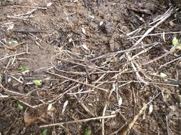
manuring
Organic manure should be applied 40—50 days before sowing
Dose of NPK and zinc depend upon verity soil type, water avalablity,rotation
Fertilizer N & P should be applied in the ratio of 1:1 to 2:1
Potassium should be applied @the rate 60—80 kg per hectare. When soil is sandy or irrigated with tube well

Slide 13
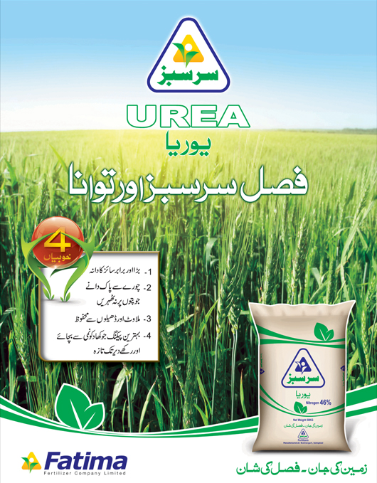
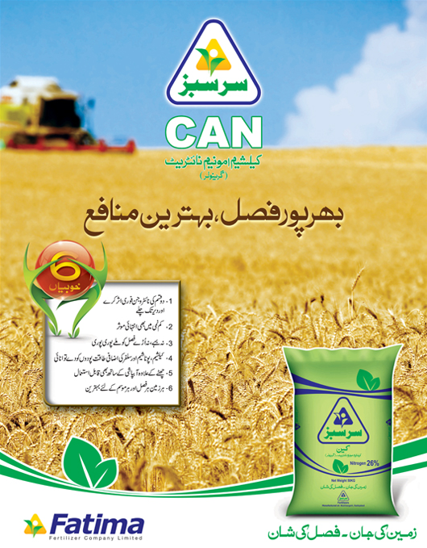
Fertilizer recommendation for wheat in Punjab (NPK kg/ha)
Low rain fall area 55-55-60
Medium rain fall area 85-55-60
High rain fall area 110-85-60
Average irrigated area 110-55-60
Rich irrigated area 85-55-0
Low fertility irrigated area 135-110-0

Slide 14
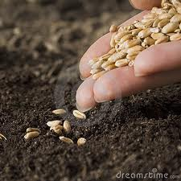
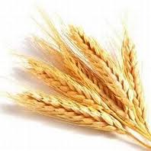
Time& seed rate
Diurnal optimum temperature 22—23 c° for germination and emergence of wheat
1st to third week of November temperature reaches the optimum range for wheat sowing for Pakistan
Seed rate
100-150 kg per ha
100kg/ha (normal sowing)
110-125kg/ha (Dec. sowing)

Slide 15
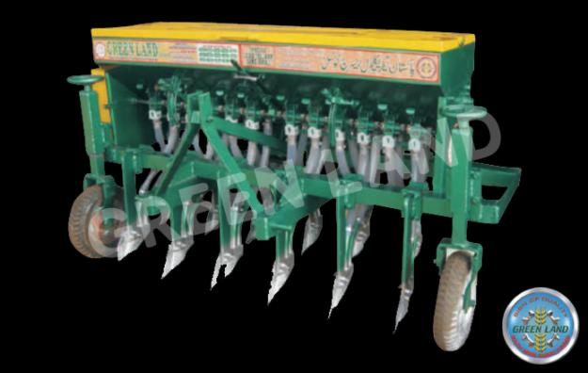
Method of planting
Irrigated areas
Drill best for sowing wheat
Kera metod
Broad cast (increase seed rate 5%)
Rain fed areas
Pora method
Drill methods
Wheat seed of new dwarf cultivar should not be sown dipper than 5 cm

Slide 16
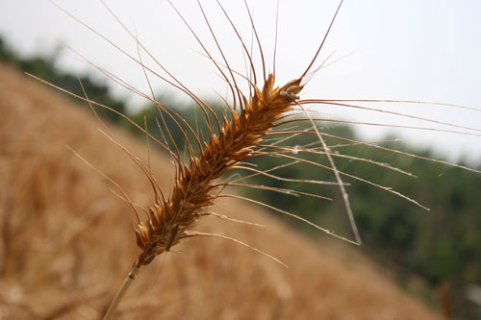
Recommended verities
Old varities
New varities
Inqilab-91
Punjab.96
M.H.97
Pasban.90
Bwp.97
Auqab.2000
Iqbal.2000
Sehar 2006
Shafiq
Faisalabad 2011
Lasani 2011
Punjab 2011
Arri 2011

Slide 17
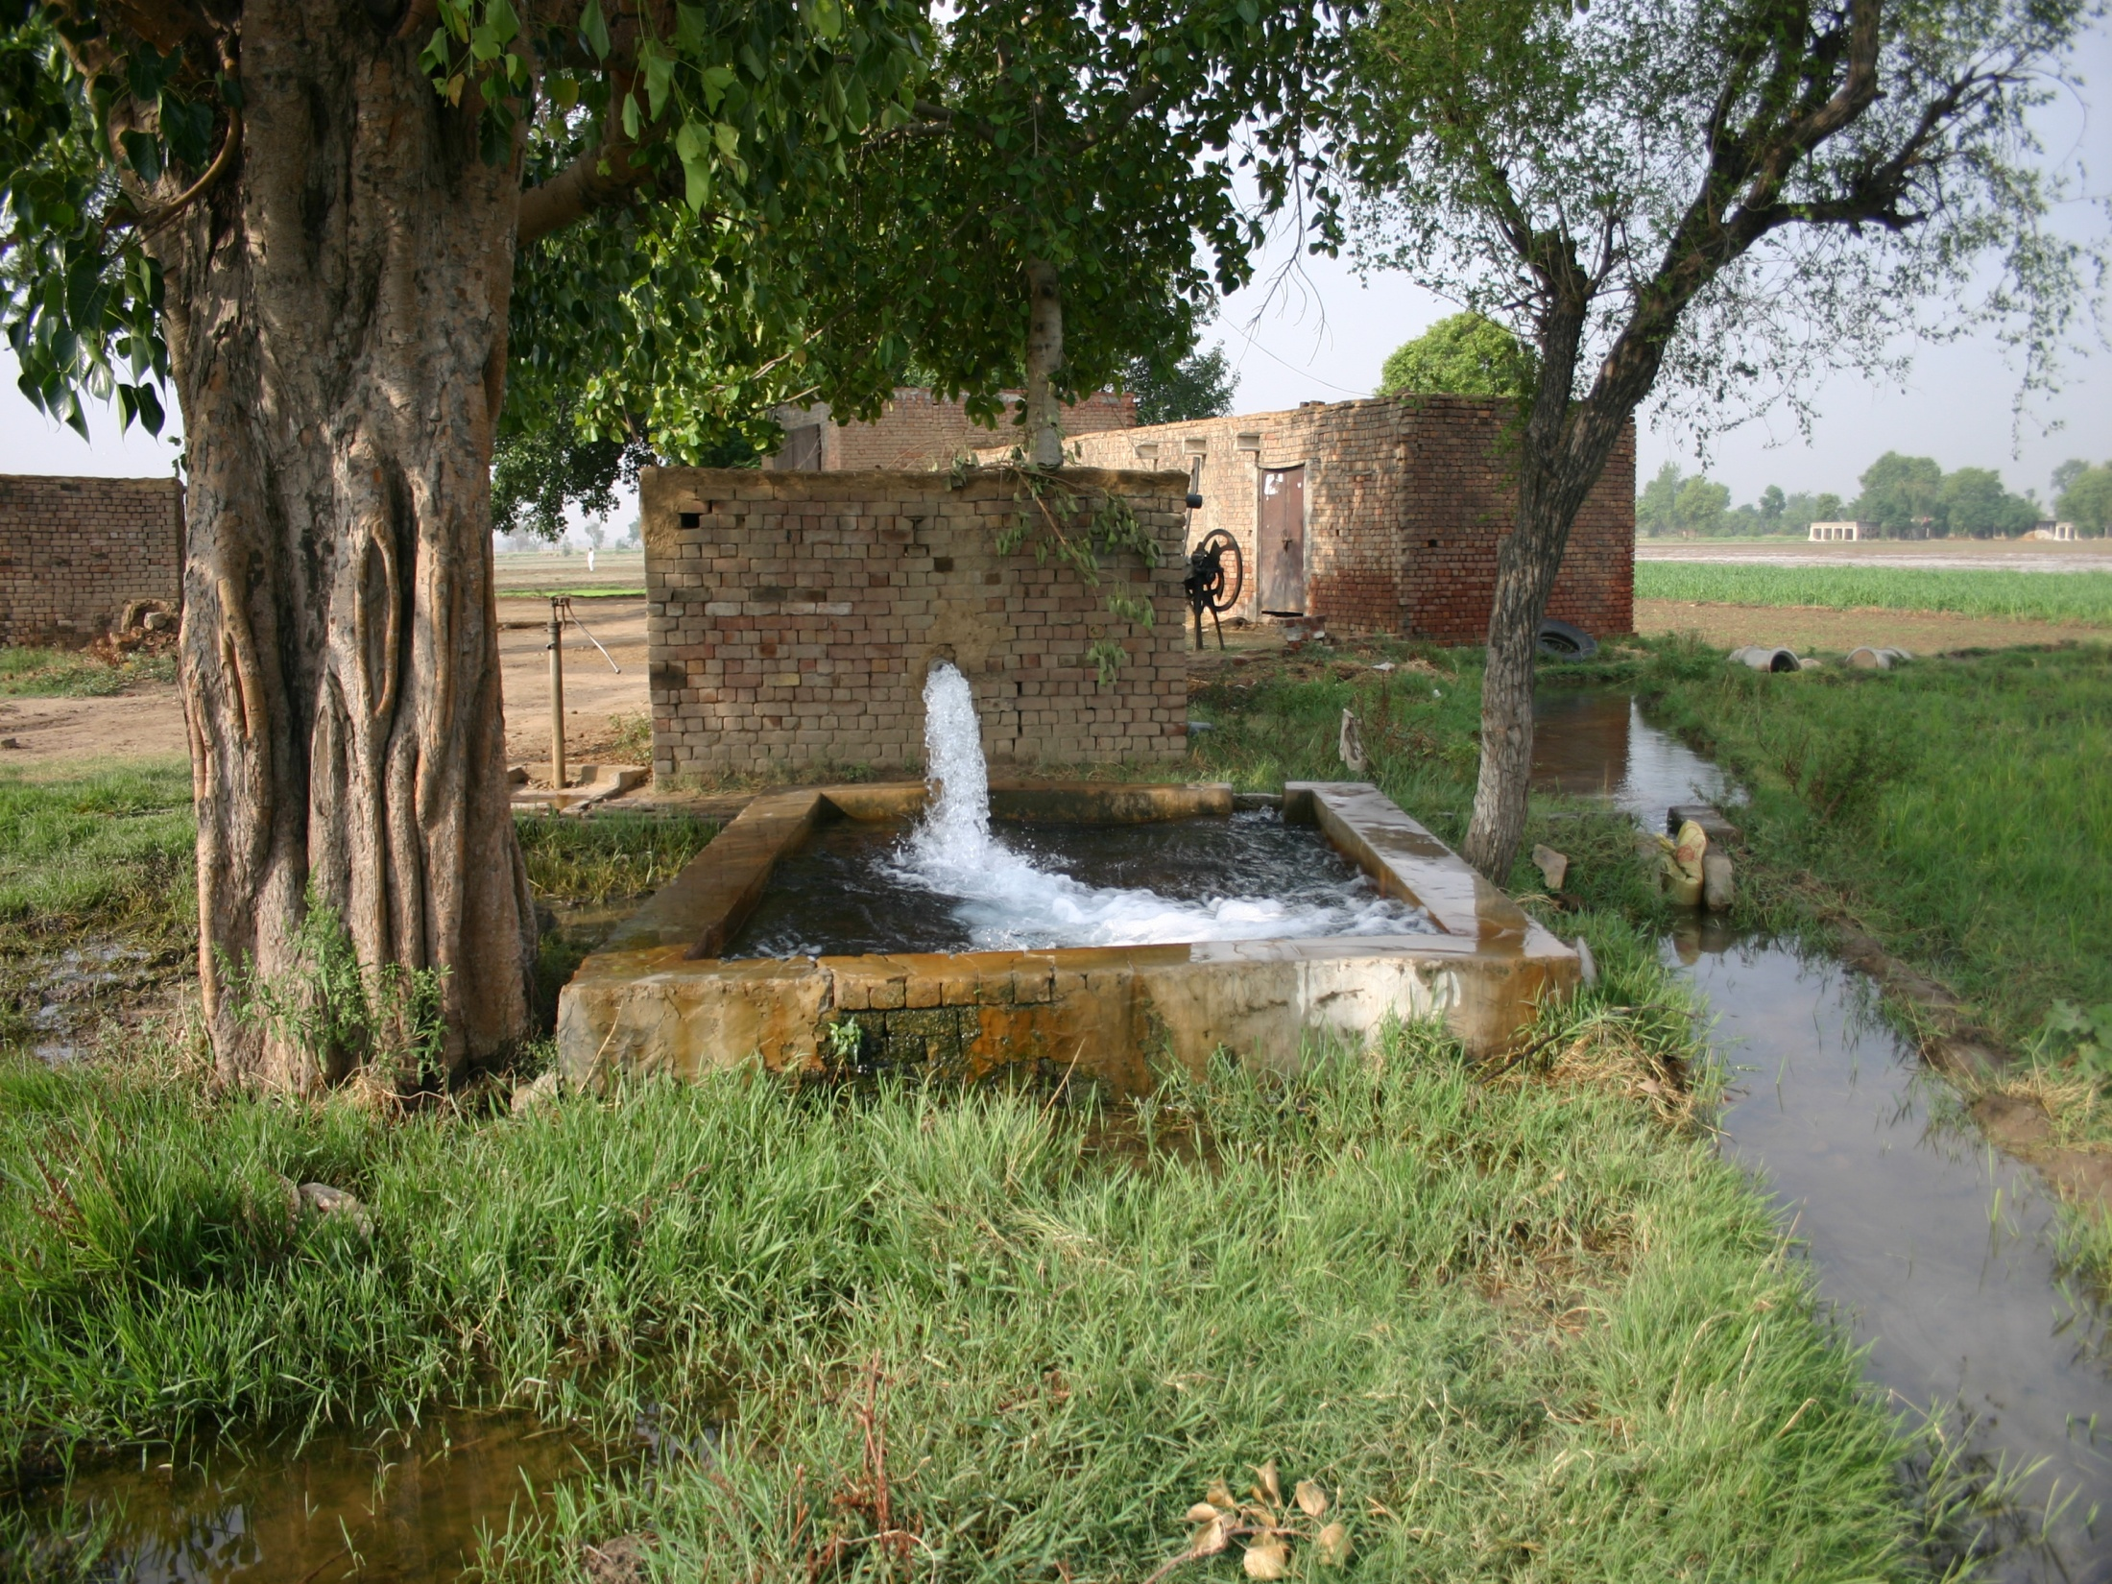
Irrigation
Wheat needs 4—6 irrigation depending upon, latitude soil type, cultivar rain fall .
Critical stages
Adventitious root development
Anthesis
Milk stage
Tillering
Spike emergence
Dough stage

Slide 18
Irrigation
Ist irrigation 20-25 days after sowing.
2nd " At booting stage.
3rd " At milk stage of grain
development.

Slide 19
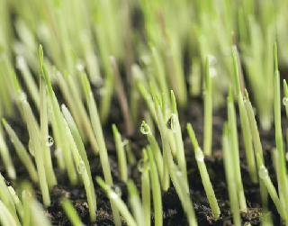
Common weeds
Phalaris minor (Dumbi sitti),
Avena fatua (Wild oats),
Chenopodium (Bathu)
Convolvulus (Lehli).

Slide 20
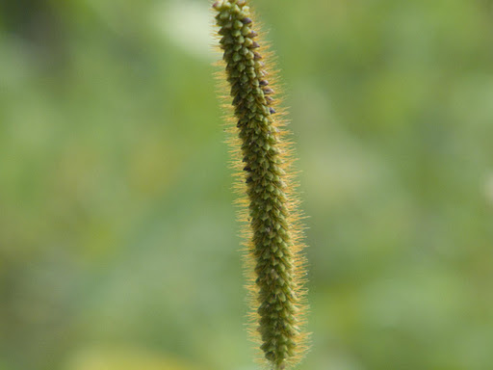
Weeds control
Cultural: Double bar harrow should be practiced.
Chemical: i) Selective weedicides for broad and narrow leaved weeds should be used.
ii) Wide spectrum weedicides can be used when both types of weeds are problem.
Note:- i) Weedicides should be applied after Ist irrigation in good moisture condition when weeds are at 2-3 & wheat crop at 3-4 leaf stages.

Slide 21
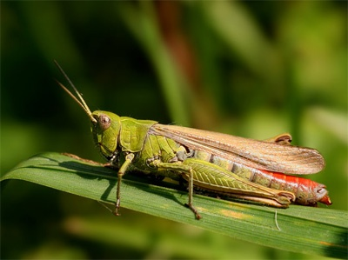
Insect pest
Insect
Pest
Grass hopper
Crickets
Aphids
Army worm
White ants
Rust of wheat
Smut of wheat

Slide 22
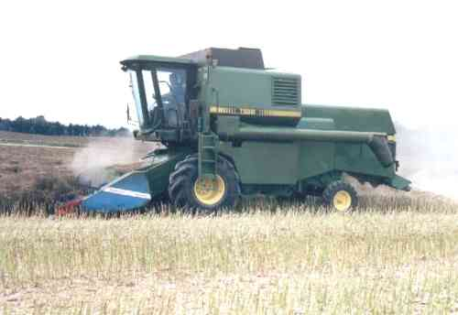
Harvesting
In all situations, grain must be harvested in a timely manner, before shattering, pre-harvest sprouting, bird damage or weathering, to minimize pre-harvest losses, yet must be dry enough for storage.
10—12 %moisture

Slide 23
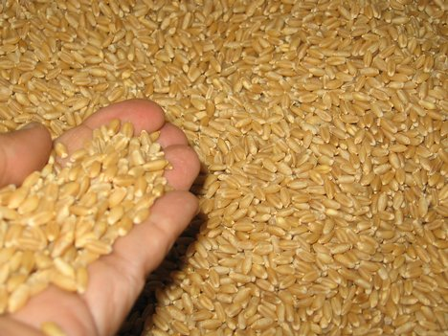
Yield
Average yield of wheat is 25-30 mounds/acre
Potential 60—75 mounds/acre

