Slide 2
Production Technology Of Tobacco

Slide 3
Tobacco
Cigarette Tobacco : Nicotiana tabacum
Hukka Tobacco : Nicotiana rustica
Family : Solanaceae

Slide 4
History
Origin :
The origion of tobacco production in pakistan (formerly hindustan ) dates to the reign of emperor Akber , when it was introduced by the europeans.
Now a days tobacco is grown in Attock , Sialkot , Peshawer , Narowal , Sahiwal etc.

Slide 5
Economic Importance
Tobacco is an important cash crop of Pakistan and brings in a cosiderable amount of foreign exchange.
It is source of employment for thousands of people who are involved with producing , curing , marketing and cigarette manufacturing.
Tobacco stem contains 0.14% of nicotine which is used as insecticides.

Slide 6
Important Varities
KPK : Sufaid and kala patta
Punjab : naki , calcatta , SL-78 , SL-75
Sindh : Rubaki , Rustica-6
Tobacco completes its life cycle in two phases
Nursery
Field

Slide 7
Raising Of Nursery
Light loam soil
Nursery bed should be located in well drained soil close to the fresh water sources
Saline soils must be avoided
Bed should be east –west orintation.

Slide 8
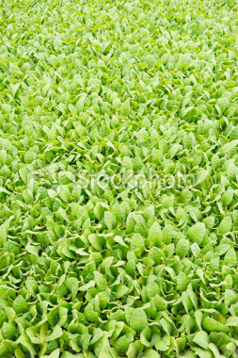

Slide 9
Bed Sterlization
To make the soil free from soil borne diseses sterlization is nesessary
There are Two Methodes of sterlization
Burning
Chemicals

Slide 10
Time And Seed Rate
Best time for nursury raising is oct- nov 15
25 to 30 g seed is enough for raising nursery for one hactare
Nursery should be transplanted after 2 to 3 months.
Hardening
Hardening is a process in which no water , no fertilizer is given to nursery before 7-10 dayes of transplanting.
Hardening prevents the seedlings from injury.

Slide 11
Soil & climate
Tobacco needs well drained , light to midium texture soil with ph 5.5-7.
saline and alkali soils should be avoided
The limiting factors in tobacco production are frost , early moonsoon rains , wind storms , hailstorms and non availability of irrigation water.

Slide 12
Transplanting of Nursery
Ideal time for transplanting of nuresry is feb-march
Transplanting is done manually by hands
Transplanting is done in standig water
One seedling is enough for one hill
nersery should be transplant in morning or evening

Slide 13
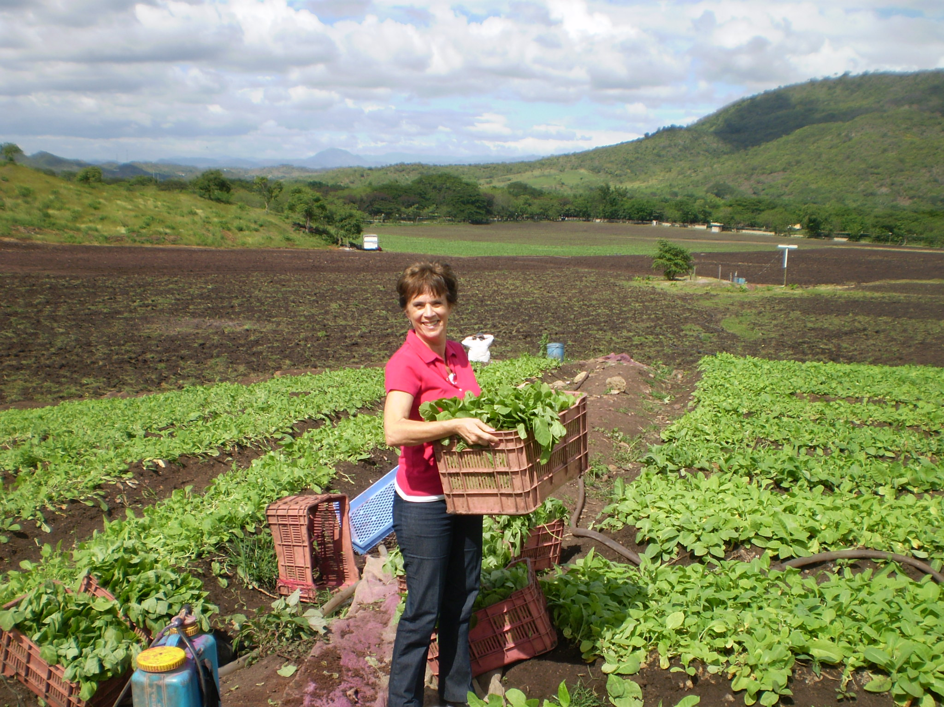

Slide 14
Field Preparation
4-5 ploughings followed by planking
After ploughing the field is divided into small plots.
Levelling is necessary
Then ridges are made

Slide 15
Fertilizer Application & Irrigation
Nitrogen
N is used to stimulate the growth and increasing the crop yield
The optimum dose of N is 35 kg/ha
Phosphorus
The optimum dose of P is 70 kg/ha
8-10 irrigations are enough for tobacco

Slide 16
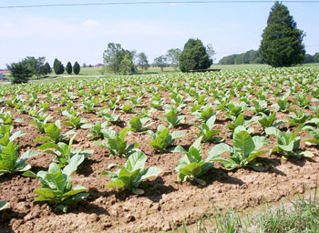

Slide 17
Plant Protection
Cut worms and jassids are important insect of tobacco.
Seven 10% dust & Diazinen 16% @ 10kg/ha.
Diseases
Tobacco mosaic
Root rot
Leaf Spot

Slide 18
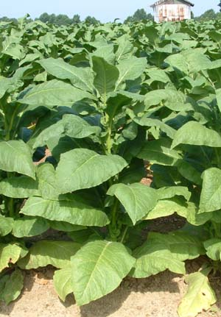

Slide 19
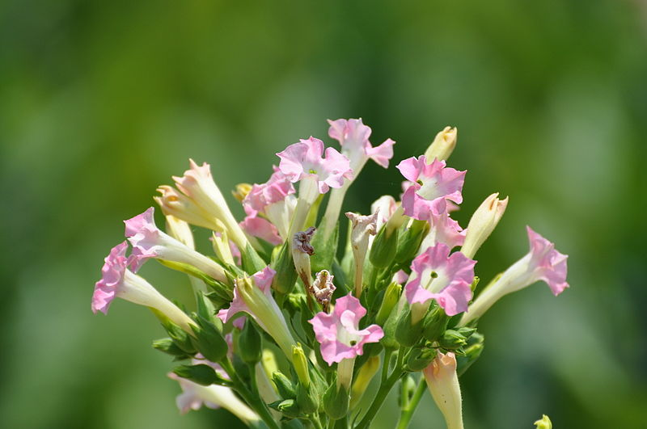

Slide 20
Interculture & Weeding
Tobacco competes poorly with weeds
So weeding is done manually
Hoeing
Hoeing is done to keep the soil aerated and to control weeds

Slide 21
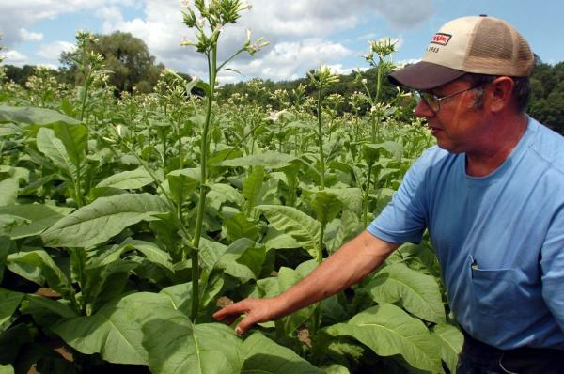

Slide 22
Topping And Descukering
Topping in tobacco is the removal of terminal bud just after the apperance of flowers head
The Removal of suckers (forth shoots ) is known as desuckering
Suckers could be controlled by suckericides like FST-7 and Royal MH-30

Slide 23
Harvesting , Drying & Curing
After muturity haravesting is done manually
Crop is dried for 2-3 days
Curing
Curing is a process in which dried crop is collected and burried in a pit for 10-15 days for bacterial fermentation
Then ropes are made

Slide 24
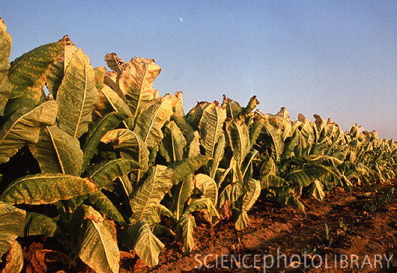

Slide 25
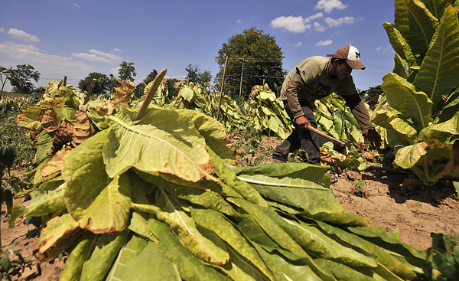

Slide 26
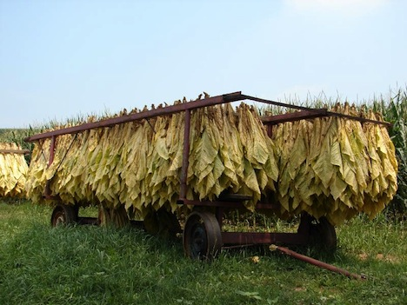

Slide 27
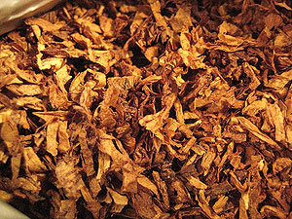

Slide 28
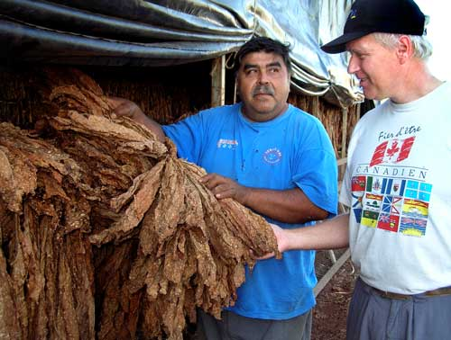

Slide 29
Yield
The leaf yield of hukka tobacco is 2500-3000 kg /ha.
The leaf yield of cigarette tobacco is 2000 kg/ha

