Slide 2
MUHAMMAD SAQIB 2008-ag-2004 B.Sc. (Hons.) DEPARTMENT OF AGRONOMY UNIVERSITY OF AGRICULTURE, FAISALABAD

Slide 3
CANAL IRRIGATION SYSTEM OF PAKISTAN

Slide 4
Road Map
Concept of irrigation and irrigation systems
Brief history of irrigation systems
Canal irrigation system of Pakistan
Types of canals
Difference between irrigation and link canals
Summary
Queries

Slide 5
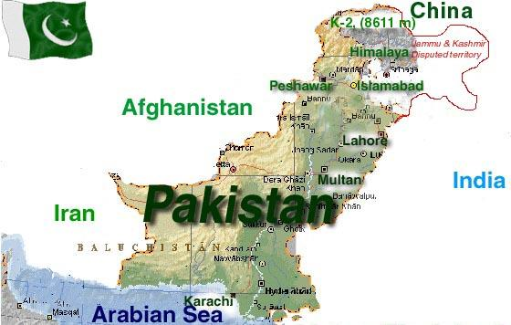

Slide 6
Irrigation
Irrigation may be defined as the science of artificial application of water to the land, in accordance with the ‘crop requirements’ through out the crop period for full-fledged nourishment of the crops

Slide 7
Pakistan’s agriculture rely heavily on irrigation.
Pakistan has the world’s largest contiguous irrigation system
Pakistan ranks 4th in the world as for as irrigated area ( About 7%) is concerned. About 36 MA( About 75% of the cultivated area) in Pakistan is irrigated land.
Pakistan has invested heavily in the irrigation sector. Allocated about $ 8 billion in this sector upto the year 2011-12
Irrigation: Life blood of agriculture

Slide 8
Irrigation System
Irrigation system is not something new
Since olden times, people have devised methods to water their fields.
Some traditional methods of irrigation are;
Shaduf
Charsa
Persian wheels
Karez

Slide 9
Types of Irrigation System
There are 2 types of irrigation system
Old irrigation system
New irrigation system

Slide 10
Old Irrigation system
Old irrigation system consist of following means
Shaduf
Charsa
Persian wheel
Karez

Slide 11
Shaduf

Slide 12
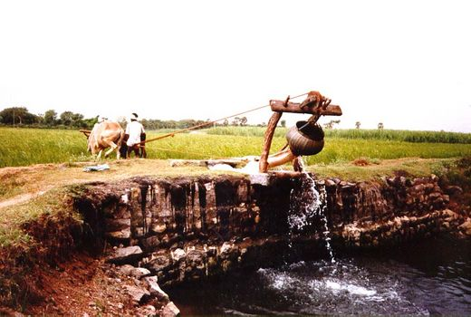
Charsa

Slide 13
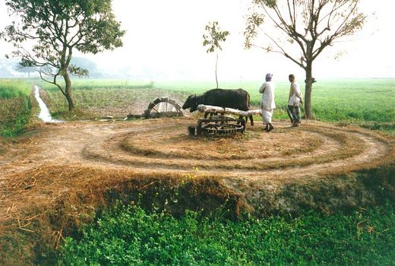
Persian Wheel

Slide 14
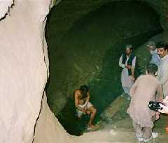
Karez

Slide 16
Karez

Slide 17
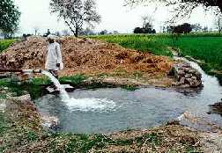
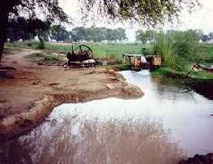
New Irrigation System
Tube wells the most important technology for groundwater irrigation is the use of tube wells with pump.
Then the water is pumped up either by electric or diesel engine.

Slide 18
New Irrigation System
Canals
Canals are taken out from rivers, barrages, headworks. Pakistan has the world’s largest canal irrigation system in the world.

Slide 19
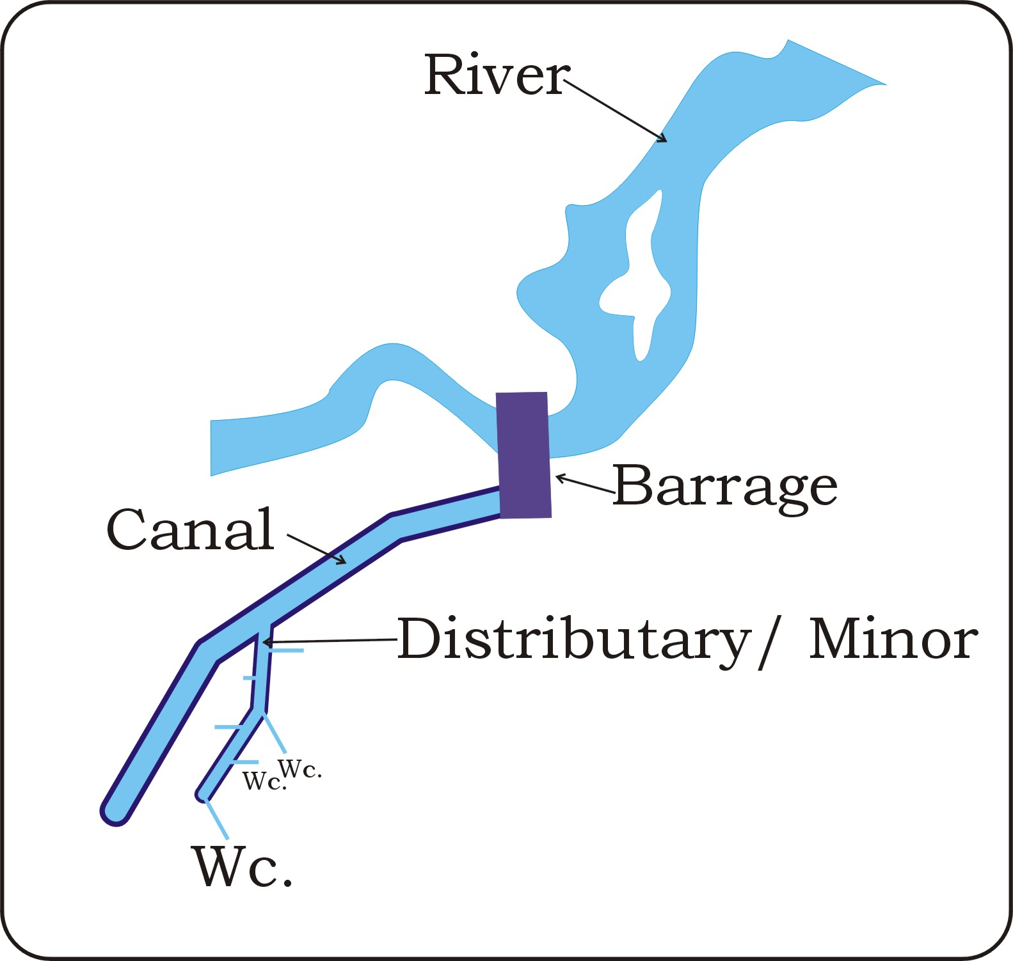

Slide 20
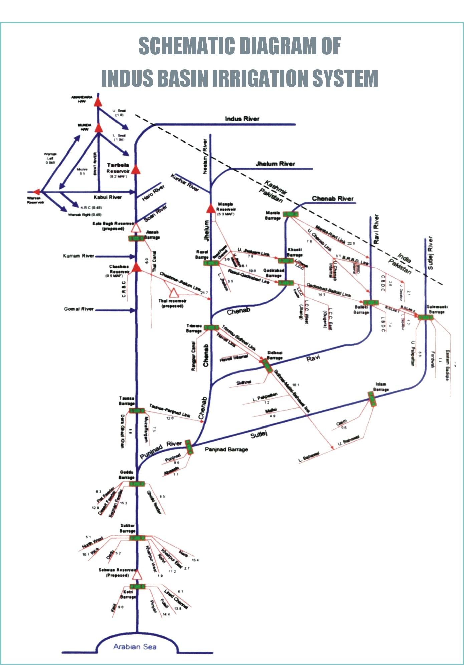

Slide 21
Irrigation System of Pakistan
Major Storage (Turbela & Mangla) | 2
Barrages | 19
Link Canals | 12
Main Canals | 43
Watercourse | 107,416
Cultivable Area | 14 million ha

Slide 22
Canals
Small-Scale Canals
Large-Scale Canals

Slide 23
Small-Scale Canals that supply water to small area.
In piedmont plains flow of torrent water
is ceased by construction of dam. This water is absorbed by land and moisture is preserved in land. In western bank of Indus river the piedmont plains of Suleiman range this system is called as Rod-I-Kohi whereas in Baluchistan it is known as Bandit.

Slide 24
Types of Canals
Perennial Canal: provide water for irrigation round the year.
Seasonal Canal/Non perennial : canals also provide water for irrigation only in summer and rainy season when river has surplus water. Some canals of river Sutlej and Ravi are non perennial.

Slide 25
Inundate Canals : receive water only in high flood situations to control the destructive action of flood water to some extent. Such canals were constructed on Indus and Chenab but these canals have been transformed in to non perennial canals.
Link Canal: supply water to canal of proximate rivers such as Sutlej and Ravi.

Slide 26
Large-Scale Canals
Large-Scale Canals originate from proper dame and barrages and consists of four types of canal. British introduced irrigation system by constructing the canal upper Bari at river Ravi in 1859.
This system is called Nahri in urdu.

Slide 27
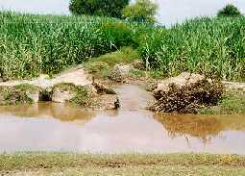
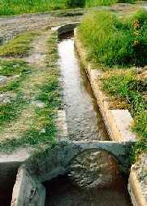
The current Indus canal network of Pakistan is the largest irrigation system in the world. Water in the Indus is first dammed by a barrage of head works. The water is fed into a main canal, then into a main branch, a major distributory, and a minor distributory. On the distributory canal, an outlet called Mogha is constructed, from which the water is fed into farmers' fields through a watercourse.

Slide 28
Canal on upper Indus Tributaries
There are 3 head works and 8 canals on river Sutlej
Sr # | Head works | Name of canals
1 | Sulaimanki | Fordwah, East Sadiqia, Pakpatan
2 | Islam | Bahawal, Qayum, Mailsi canal
3 | Punjnand | Abasia canal,Punjnand canal

Slide 29
Canal of River Ravi
2 Head works and 2 canals
Sr # | Head works | Name of canals
1 | Balloki | Lower Bari Doab
2 | Sidhnai | Sidhni Canal

Slide 30
Canal of River Chenab
There are 3 head works and 4 canals on river Chenab
Sr # | Head works | Name of canals
1 | Marala | Upper Chenab canal
2 | Khanki | Lower Chenab canal
3 | Qadir Abad | Rangpur,Main canal

Slide 31
Canal of River Jehlum
There are One Dam 2 head works and 4 canals on river Jehlum
Sr # | Head works | Name of canals
1 | Mangla | Upper Jehlum canal
2 | Rasool | Lower Jehlum canal
3 | Trimmu

Slide 32
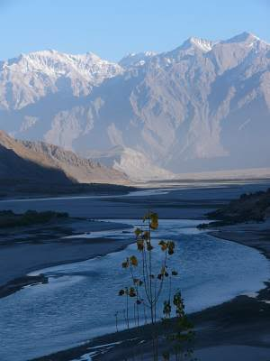

Slide 33
Canal Irrigation System on River Indus
There are one Dam Called Terbella Dam ,6 Barrages and 18 Canals which provide irrigation water to all the provinces of Pakistan
Sr # | Head works | Name of canals
1 | Jinnah | Upper Thal Canal. South Thal canal.
2 | Chashma | Chashma-Trimmu link canal,Right Bank canal

Slide 34
Sr # | Head works | Name of canals
3 | Taunsa | Right bank and left bank canal, taunsa-punjnand link canal
4 | Guddu | Ghotki,Begari,Desert Pat Feeder canal
5 | Sukkur | NorthWest,Rohri, Nara,East khairpur,Westkhairpur, Rice,Dadu Canals
6 | Ghulam Muhammad /Kotri | Kotri,phuleli,penyari,kalri canal

Slide 35
Irrigation System West of Indus
Sr # | Rivers | Name of canals
a | Swat | Upper Swat,lower Swat
b | Kabul | Warsik Dam and 2 canals
c | kurrum | 1 Canal

Slide 36
Link canals under Indus Water Treaty
Rasul (Jehlum) to Qadir Abad (Chenab)
Qadir Abad (Chenab) to Balloki (Ravi)
Balloki (Ravi) to Sulemanki (Sutlej)
Chashma (Indus) to Jehlulm
Trimmu (Jehlum) to Sidhnai(Ravi)
Sidhnai(Ravi) to Mailsi Bahawalpur (sutlej)
Taunsa (Indus) to Punjnand

Slide 37
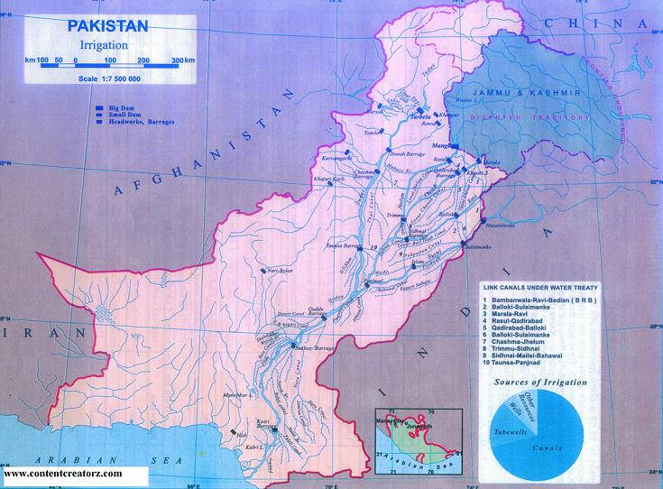

Slide 38
Punjab
The public irrigation infrastructure in the Punjab consists of 13 barrages, 2 siphons across major rivers, 12 link canals and 23 major canal systems over an aggregate length of 34,500 km
The whole irrigation infrastructure lies within the Indus Basin System.

Slide 39
Sindh
Sindh has 14 publicly owned irrigation systems, which receive water from three barrages across the River Indus. These systems, with an aggregate length of 18,000 km of canals

Slide 40
NWFP
NWFP has five publicly owned irrigation systems in the Indus Basin
These systems receive water from two head works
In addition, there are six other canal system
NWFP has over 200 canals called `civil canals`, which are community or privately owned

Slide 41
Baluchistan
Baluchistan has two canal systems, which receive water from the Indus Basin System through Guddu Barrage and Sukkur Barrage, located in Sindh.
One of these, the Pat Feeder Canal System, has been improved recently
In addition, there are 431 independent publicly owned small irrigation schemes
There are a few privately owned small irrigation schemes too.

Slide 42
Canal on upper Indus Tributaries
There are 3 head works and 8 canals on river Sutlej
Sr # | Head works | Name of canals
1 | Sulaimanki | Fordwah, East Sadiqia, Pakpatan
2 | Islam | Bahawal, Qayum, Mailsi canal
3 | Punjnand | Abasia canal,Punjnand canal

Slide 43
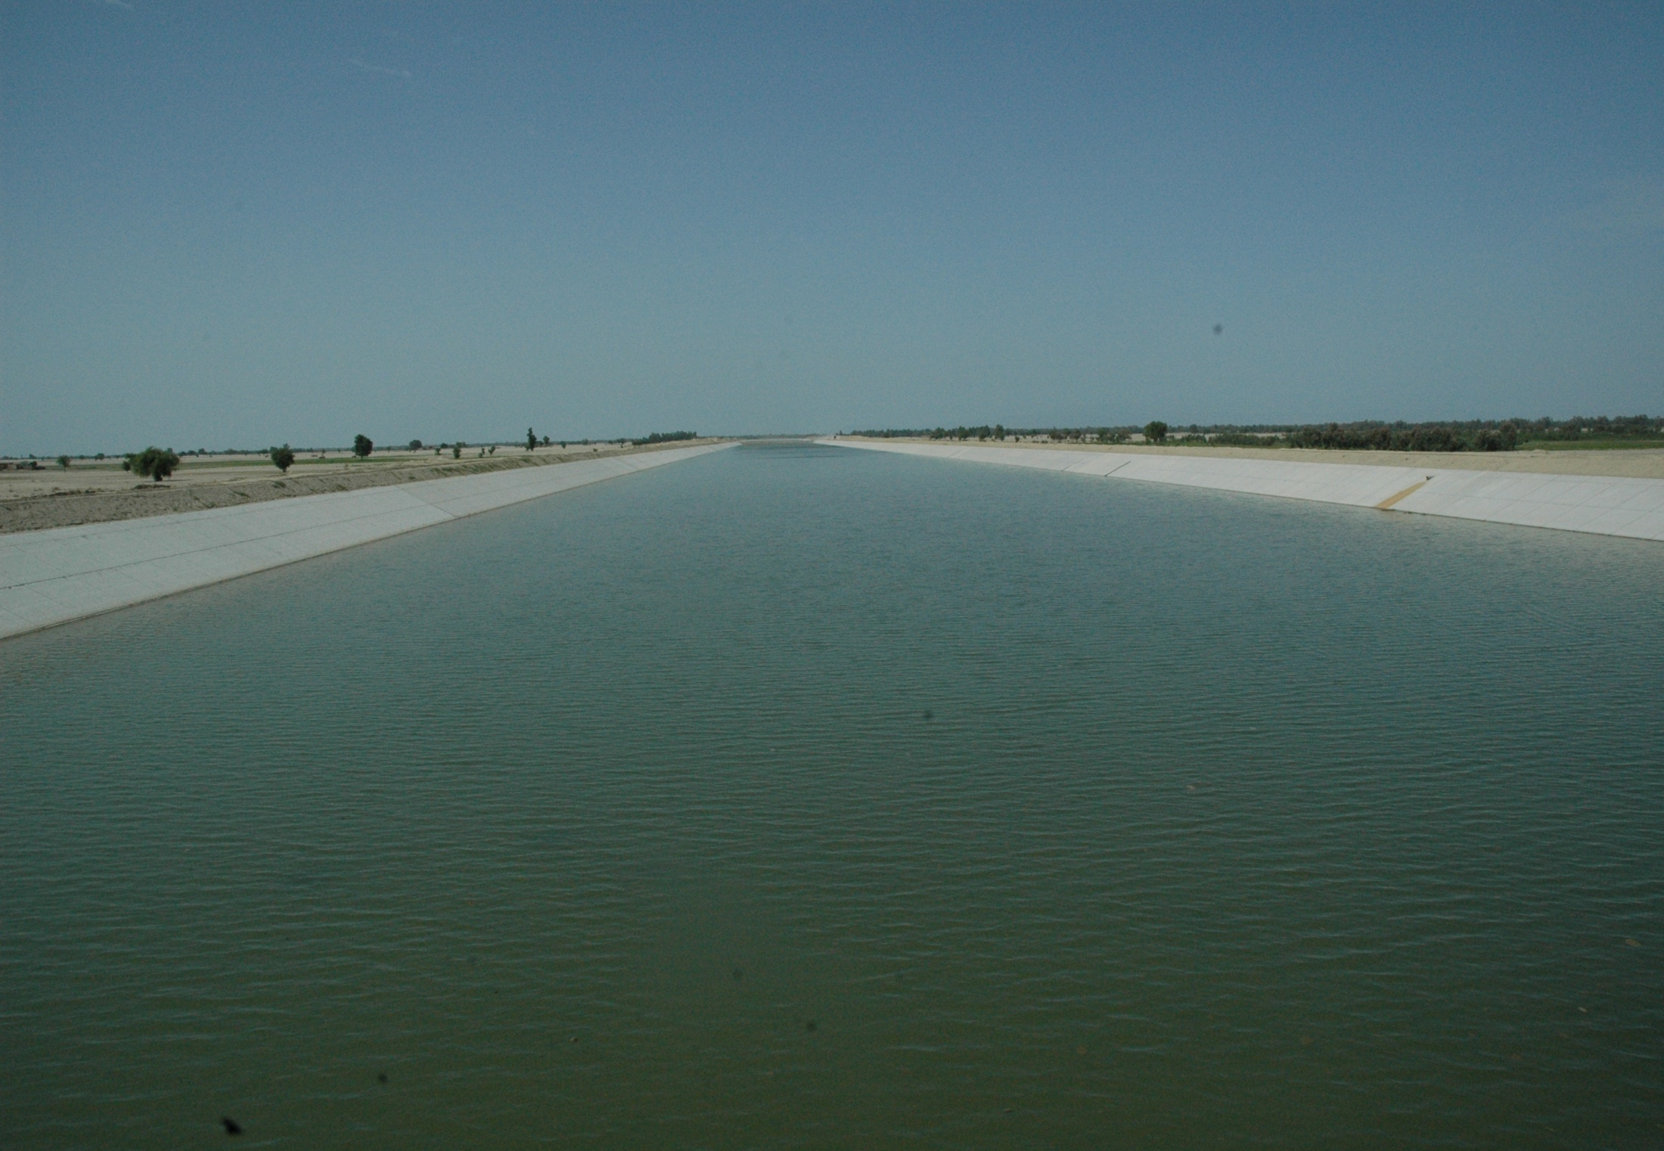
MAIN CANAL

Slide 44
WAY FORWARD
National Water Policy
Provincial Water Visions in Accordance with Post IWT Scenario 1961 – Indus Water Apportionment Accord 1991 (CBM’s)
Creation of Think tank ( Planning Commission, HEC, Universities, PEC, PSAE) for Water Resources Development and Management

Slide 45
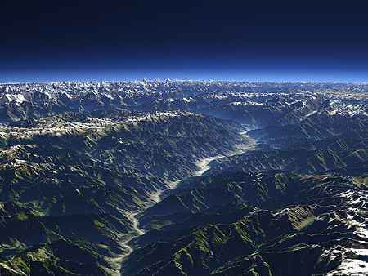

Slide 47
Resource Conserved
Is
A Resource Generated
http://www.sacanasia.org
THANKS

