Slide 2
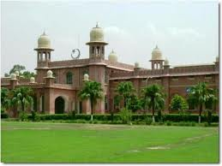
AHSAN RIAZ
2008-ag-1811
CROP ROTATION

Slide 3
CROP ROTATION
It is a technique of growing different crops on a same land over a definite period of time in such a manner so that the fertility of the soil is least effected and profit is maintained

Slide 4
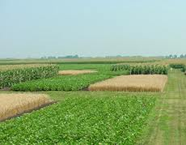
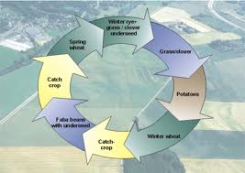

Slide 5
Why C.Rotation is necessary?
Monoculture
For sustainability
Weed infestation
Reduce soil erosion
Maintain soil Biota
IPM

Slide 6
Duration of Rotation:
Rotation sequance or patterns could be of duration
ranges from 1---3 years. This may include at least one
cover crop and legume

Slide 7
Two crops on the field in a year
Maize ------ Wheat
Rice ------ Wheat
Cotton ------ Wheat
Rice ------ Berseem
Rice ------ Field beans

Slide 8
Three crops on the field in a year
Maize---- Wheat ------Mash
Rice -----Wheat------Green grams
Four crops on the field in a year
Cabbage -----cauliflower-----Onion-----Maize

Slide 9
Principles of C.rotation
Crop of same family and same root system should not followed after each other.
Long duration crop followed by short duration crop.eg. S.cane----Peanut.
Exhaustive crops should be followed by restorative crops.eg cereals-----legumes.
Anaerobic crops followed by aerobic crops. e.g. Rice----wheat
Susceptible crops to must replaced by resistant crops.

Slide 10
6. Green manuring crops should succeed grain or other crop.eg) Mung bean-----wheat
7. Crops requiring more and deep tillage should be followed by other crops to save labor
e.g. cotton---berseem
8. Rotation should supply food grains and feed
9. Crops in rain fed /barani /drought prone areas should succeeded by fallowing.

Slide 11
Advantages of C.rotation
Maintain soil fertility
Improves physical condition of soil
Minimizes risk of plant diseases/insects
Provides vegetative cover to the soil and prevents erosion by rains/floods and winds
Rotation cover the natural and market risks and avoids sudden failure
Better utilization of labour and other resources and help in regular flow of income

Slide 12
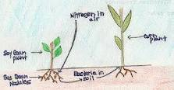

Slide 13
Rotation Planning
Farm resources (water, labor and capital)
Available technology i.e. good seeds and equipments
Farm enterprise i.e. dairy/poultry farming
The commodity market and price
Transportation facilities (roads, trucks)
Managerial skills and staff for farm operations
Farmer’s needs

Slide 14
Cont…...
Goals of farmers, that could be more profit, pest control, risk coverage
Government policies and intensives i.e. subsidy/loans

Slide 15
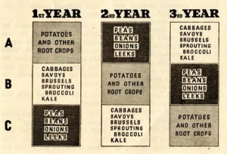

Slide 16
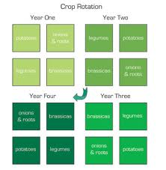

Slide 17
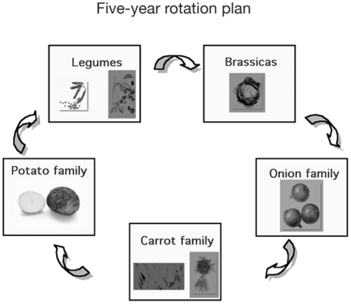

Slide 18
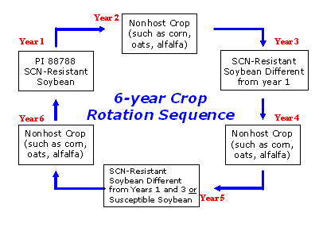

Slide 19
Factors effecting C.Rotation
Natural environmental condition
Type of soil
Availability of fertilizers
Availability of labor
Irrigation
Situation of farm
Size of farm
Weeds
Market price

